Slide 1
EudraCT Project
Simon Bond 30th April 2019

Slide 2
Elevator Pitch
All CTIMP studies are required to enter results into EudraCT within 1 year of completion
Detailed safety results could take 1000s of hours to enter by hand
Or upload an XML with the data in seconds.

Slide 3
Overview
Update on Safety data project
Worked Example
Where to find resources
Opportunities to contribute
Discussion on Future extensions
Notes:
<number>

Slide 4
Project Timelines: End date is October 19
Survey
Specification Document
Website
Github code sharing and collaboration
Draft versions of code
Testing
Documentation

Slide 5
Doing one thing well (to start with)
Produce summary safety stats
Advisory code not tested, or use your own
Versions for R, Stata, SAS
Data provided to link to EudraCT codes for SOCs
Standardise column names and save in “simple” XML
R package function - tested
SAS Proc Datasets (but limited by variable name length)
Stata code
XSLT script to convert from “Simple” to EudraCT xml.

Slide 6
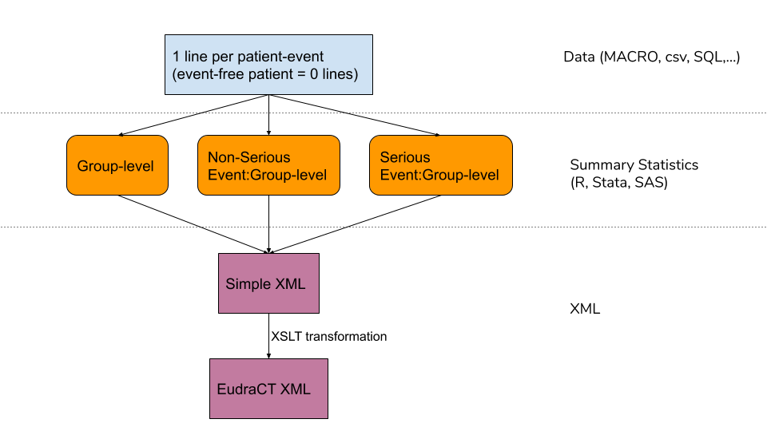
Flow Chart of process

Slide 7
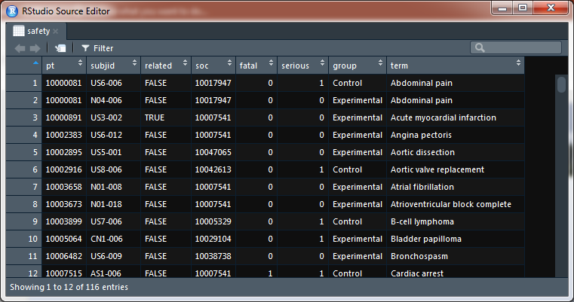
Input Data

Slide 8
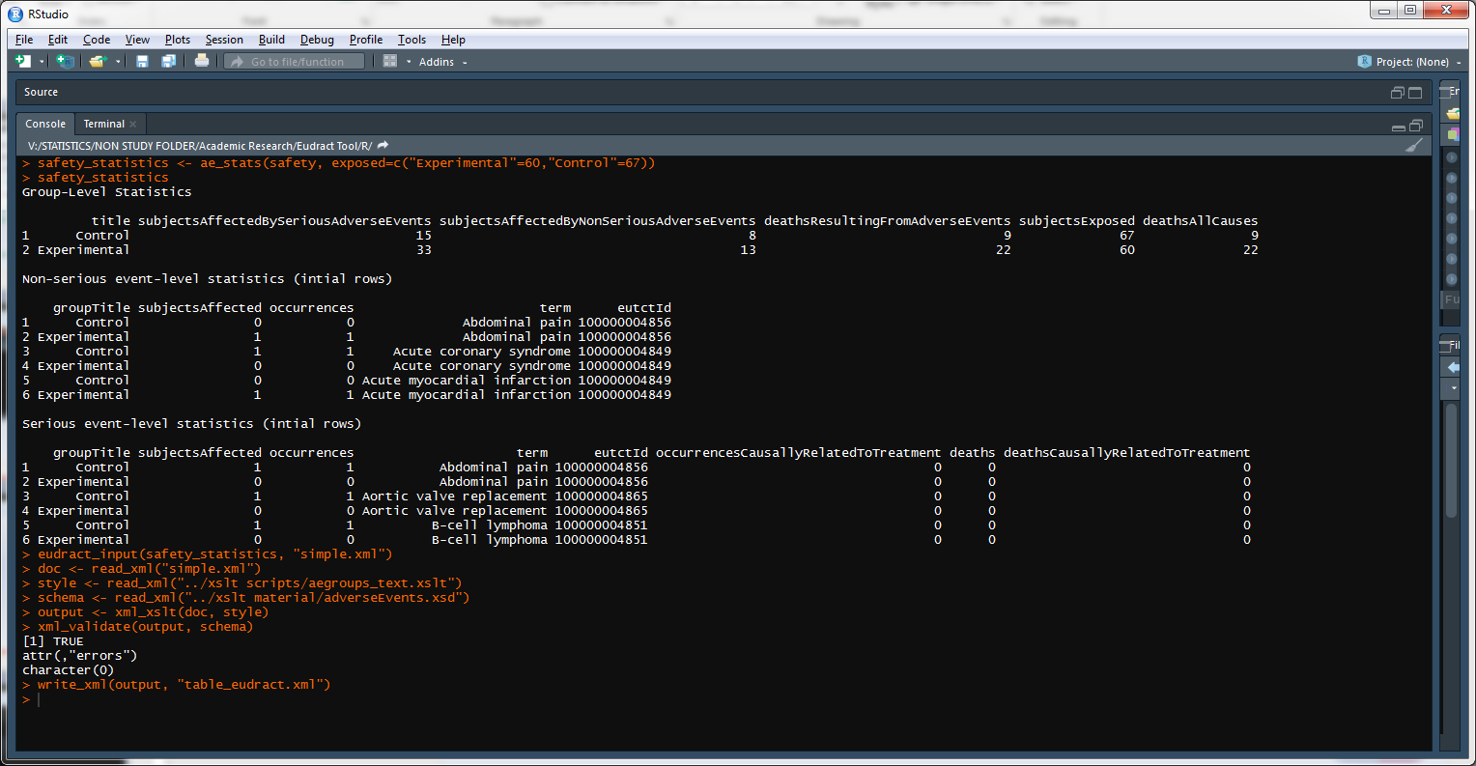
R Code

Slide 9
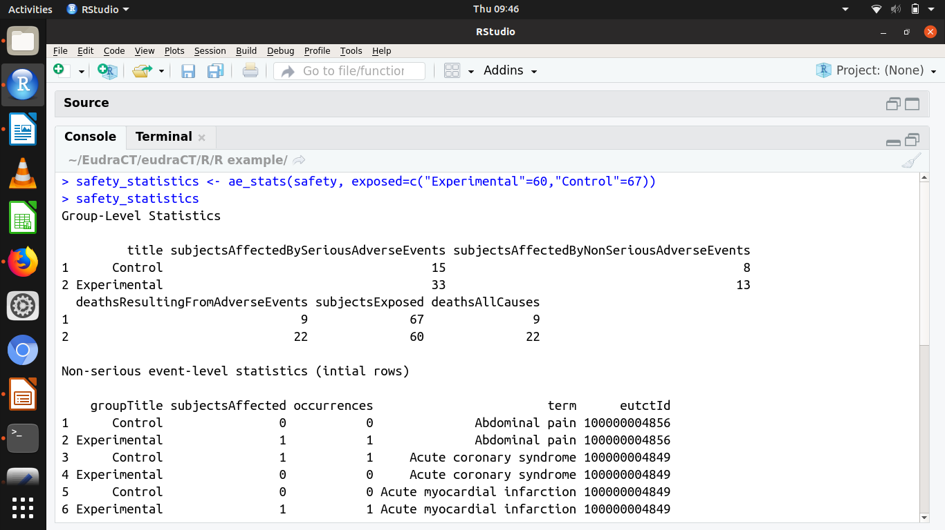

Slide 10
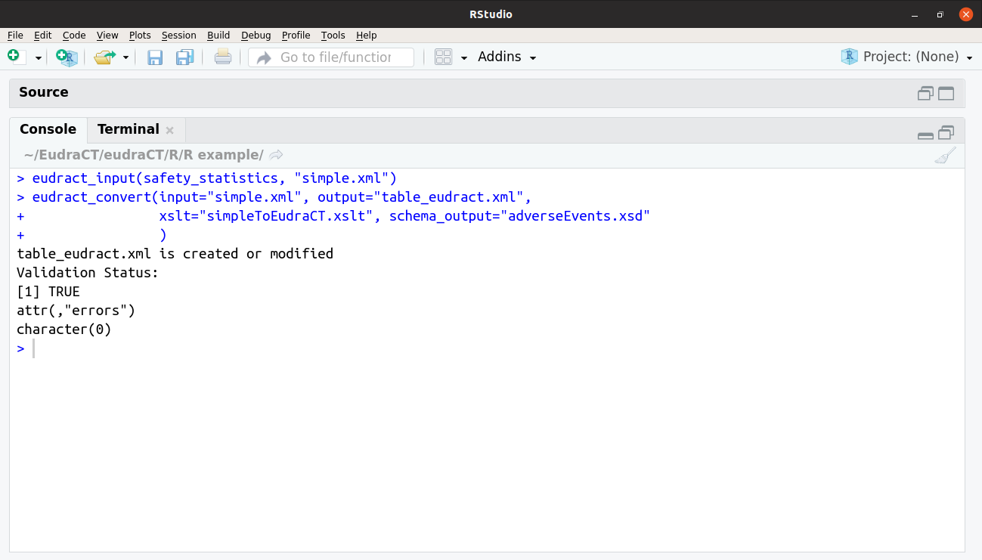

Slide 11
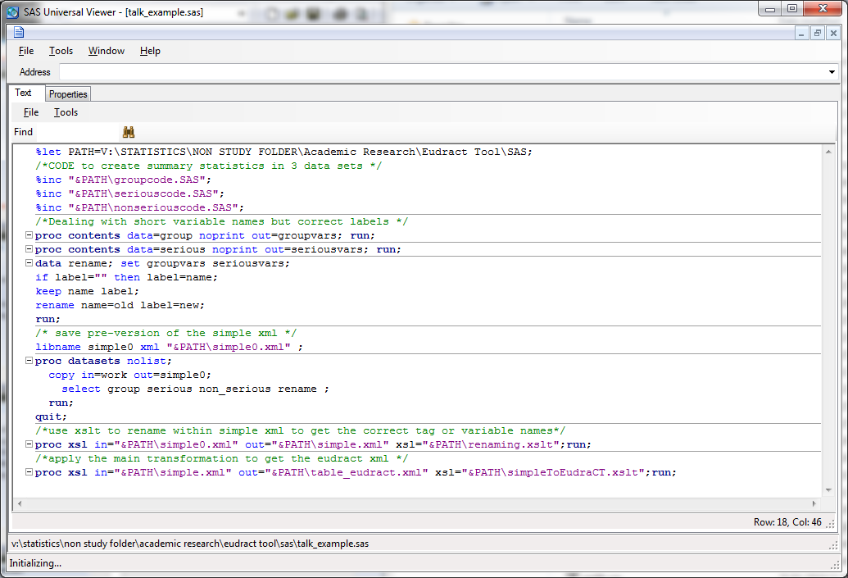
SAS Equivalent

Slide 12
Show off the final result Somehow

Slide 13
SAS Equivalent

Slide 14
Show off the final result Somehow

Slide 15
SAS Equivalent

Slide 16
Show off the final result Somehow

Slide 17
SAS Equivalent

Slide 18
Show off the final result Somehow

Slide 19
SAS Equivalent

Slide 20
Show off the final result Somehow

Slide 21
SAS Equivalent

Slide 22
Show off the final result Somehow

Slide 23
SAS Equivalent

Slide 24
Show off the final result Somehow

Slide 25
SAS Equivalent

Slide 26
Show off the final result Somehow

Slide 27
SAS Equivalent

Slide 28
Show off the final result Somehow

Slide 29
SAS Equivalent

Slide 30
Show off the final result Somehow

Slide 31
SAS Equivalent

Slide 32
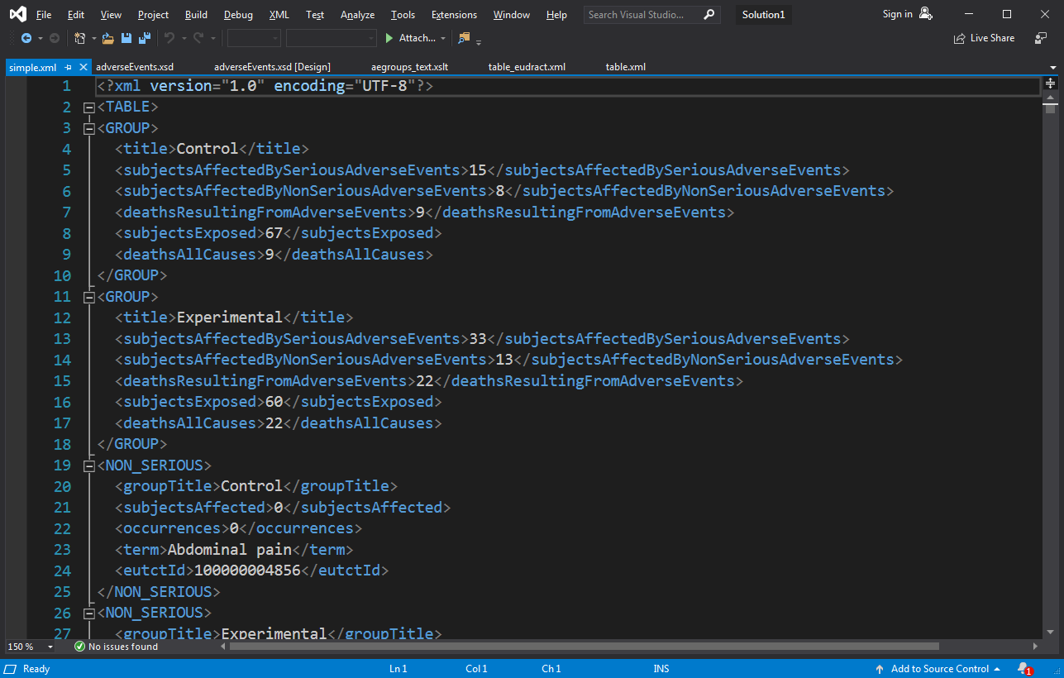
Save in Simple xml with standard names

Slide 33
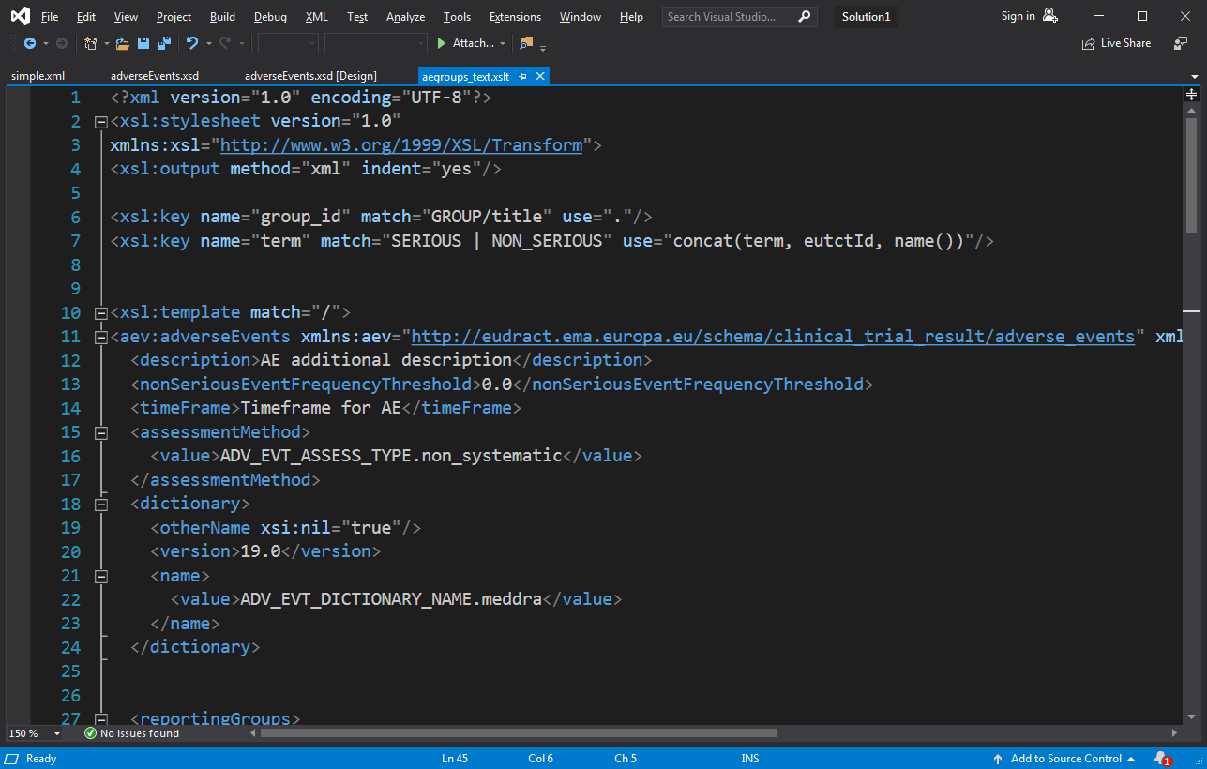
Transformation code: 108 lines

Slide 34
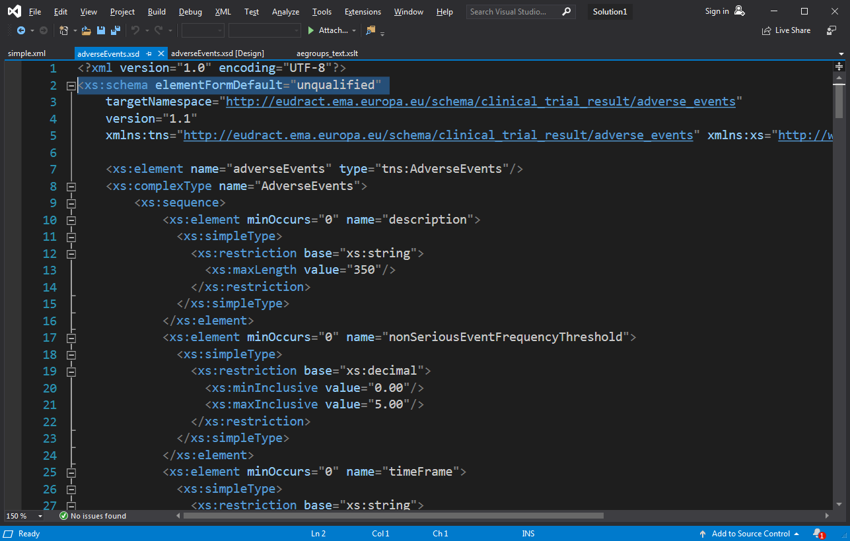
Schema downloaded from EudraCT

Slide 35
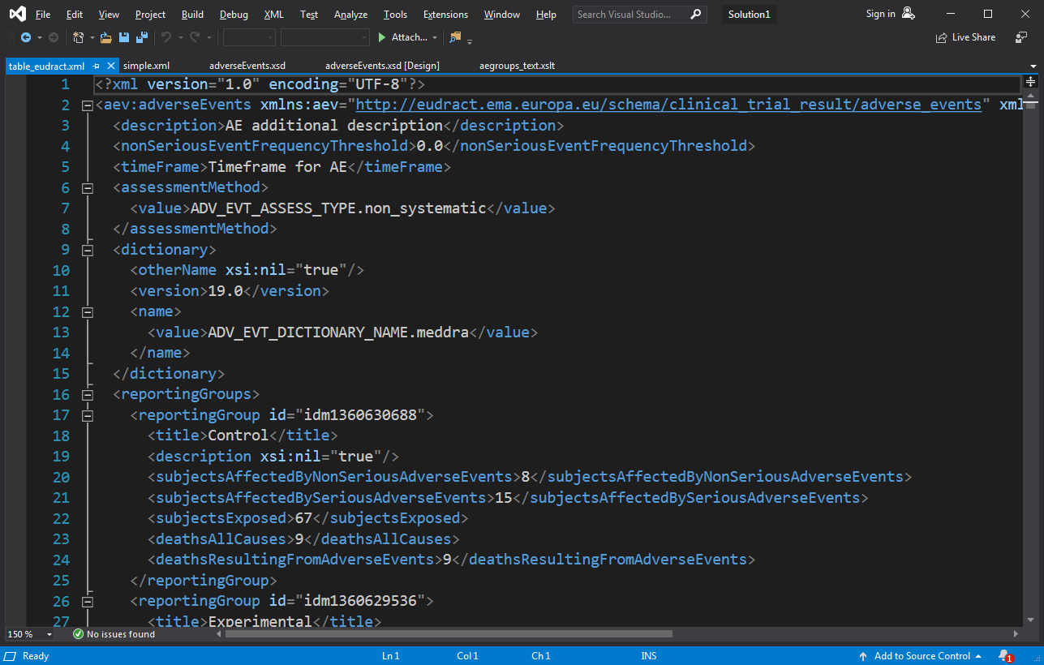
Final Output

Slide 36
SAS Equivalent

Slide 37
Unification across R/SAS/Stata
Could export directly writing output mixing text and data
Print (“<blah>”, count[i,j], “</blah>”)
One unified XSLT stage for the details
Easy to amend for future changes
Open-source code on GitHub for anyone to propose amendments
Leaves the statisticians to do statistics
Need to export into “Simple” XML from Stata

Slide 38
Show off the final result Somehow

Slide 39
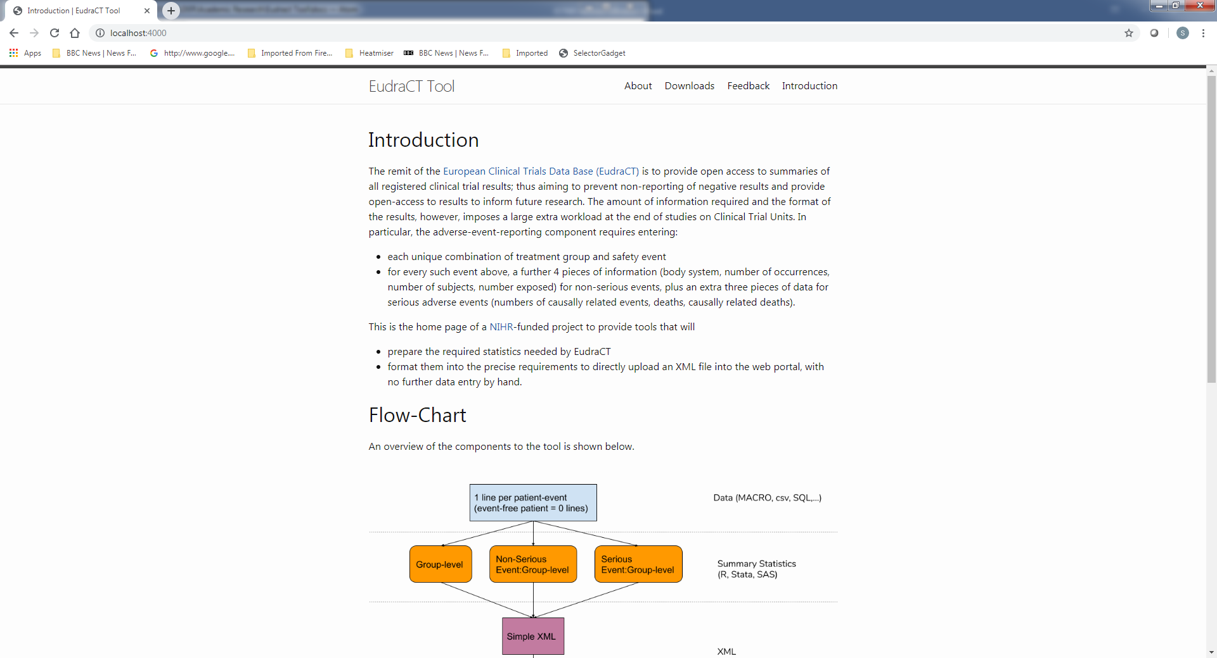
https://eudract-tool.medschl.cam.ac.uk

Slide 40
Where can you get this
R code in a zip file with worked example
SAS code equivalent..
Stata code equivalent?
R Code -> package via the github link
Documentation
Training

Slide 41
Test overview
Use the training version of EudraCT
Take a past trial already uploaded to EudraCT from another CTU, and compare output
Unit testing within R, Stata,SAS.
Feedback from other units welcome

Slide 42
Acknowledgments

Slide 43
Future Direction: Discussion
Extensions:
Baseline
Efficacy
Meta Data
Beyond EudraCT
ClinicalTrials.gov
CDISC

